Slide 1

DEEP NEURAL NETWORK MODULE # 3 : LINEAR NEURAL NETWORKS FOR REGRESSION
DNN Team
BITS Pilani WILP

Slide 2
The instructor is gratefully acknowledging the authors who made their course materials freely available online.
This deck is prepared by Seetha Parameswaran.
Deep Learning

Slide 3








Table of Contents
Regression
Linear Regression
The Linear Model: Single Neuron
Worked Example
Evaluation
Python Implementation Implementation Tips
Summary
1
2
3
4
5
6
7
8
Deep Learning

Slide 4


Table of Contents
1
Regression
Linear Regression
The Linear Model: Single Neuron
Worked Example
Evaluation
Python Implementation Implementation Tips
Summary
2
3
4
5
6
7
8
Deep Learning

Slide 5
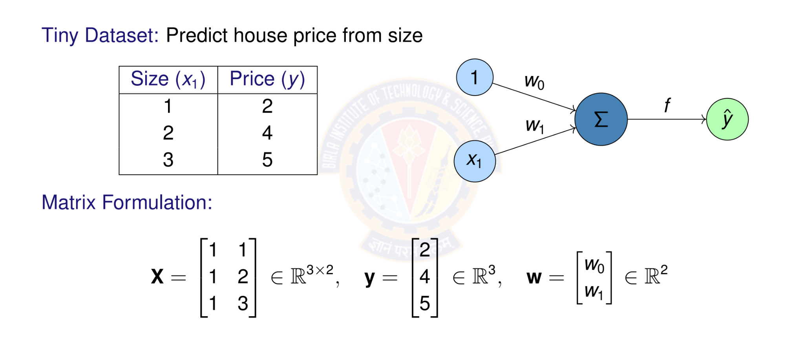
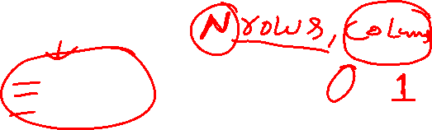
Numerical Example: Setup
Deep Learning

Slide 6
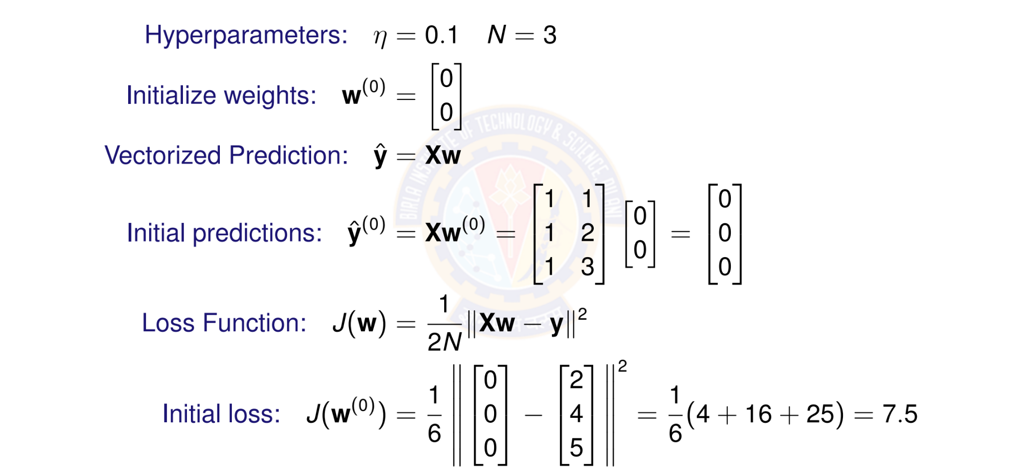

Numerical Example: Initialization
Because we predicted 0 for everything, our error is large, so loss is 7.5
Deep Learning

Slide 7
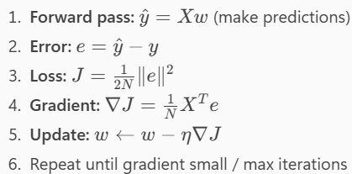


Slide 8
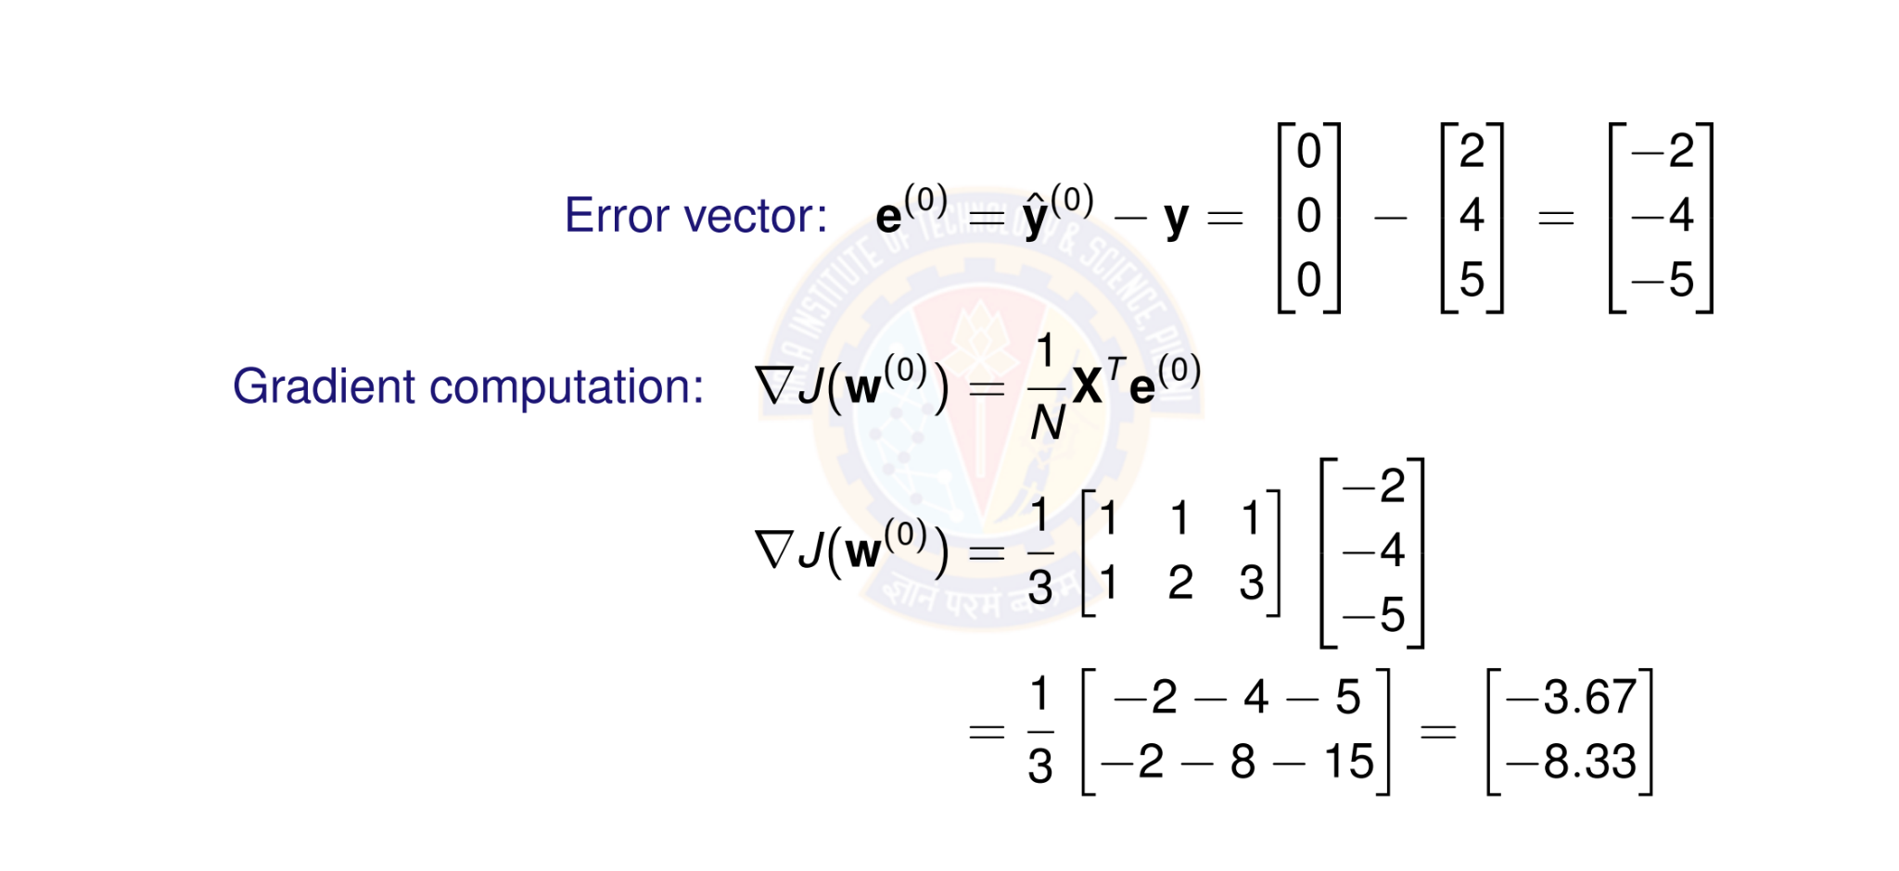
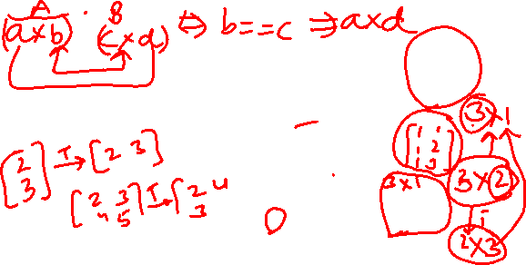
Numerical Example: Computing Gradient
Deep Learning

Slide 9
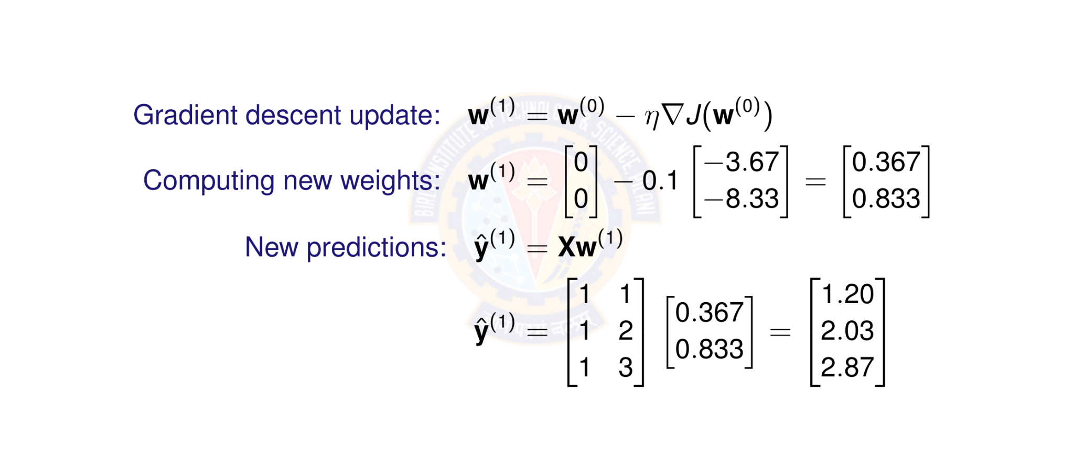
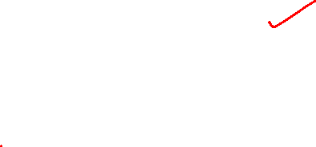
Numerical Example: Weight Update
Deep Learning

Slide 10
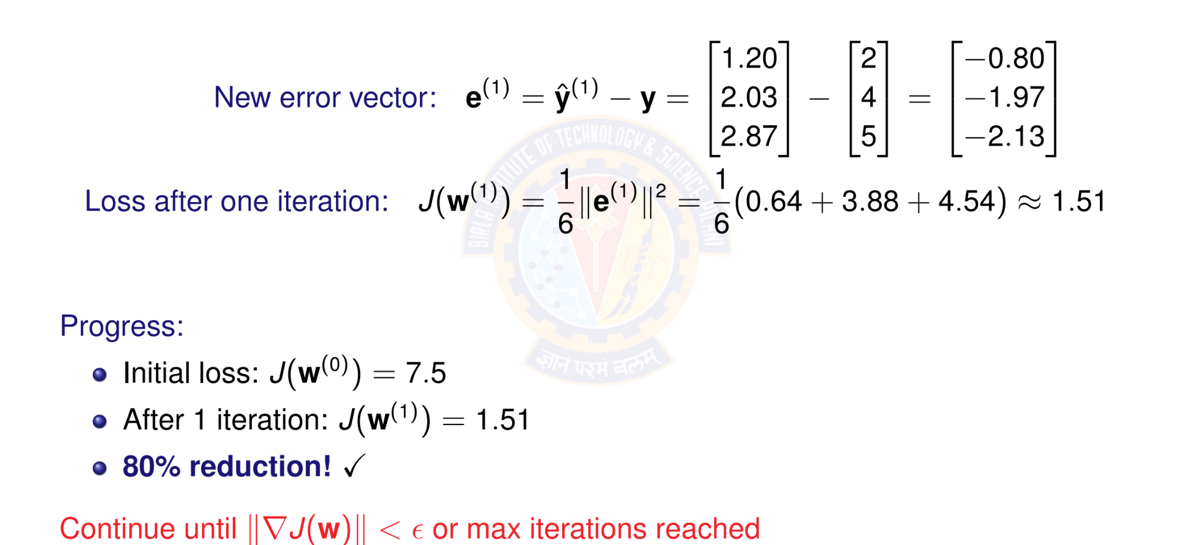
Numerical Example: New Loss
Deep Learning

Slide 11

Table of Contents
Regression
Linear Regression
The Linear Model: Single Neuron
Worked Example
Evaluation
Python Implementation Implementation Tips
Summary
1
2
3
4
5
6
7
8
Deep Learning

Slide 12
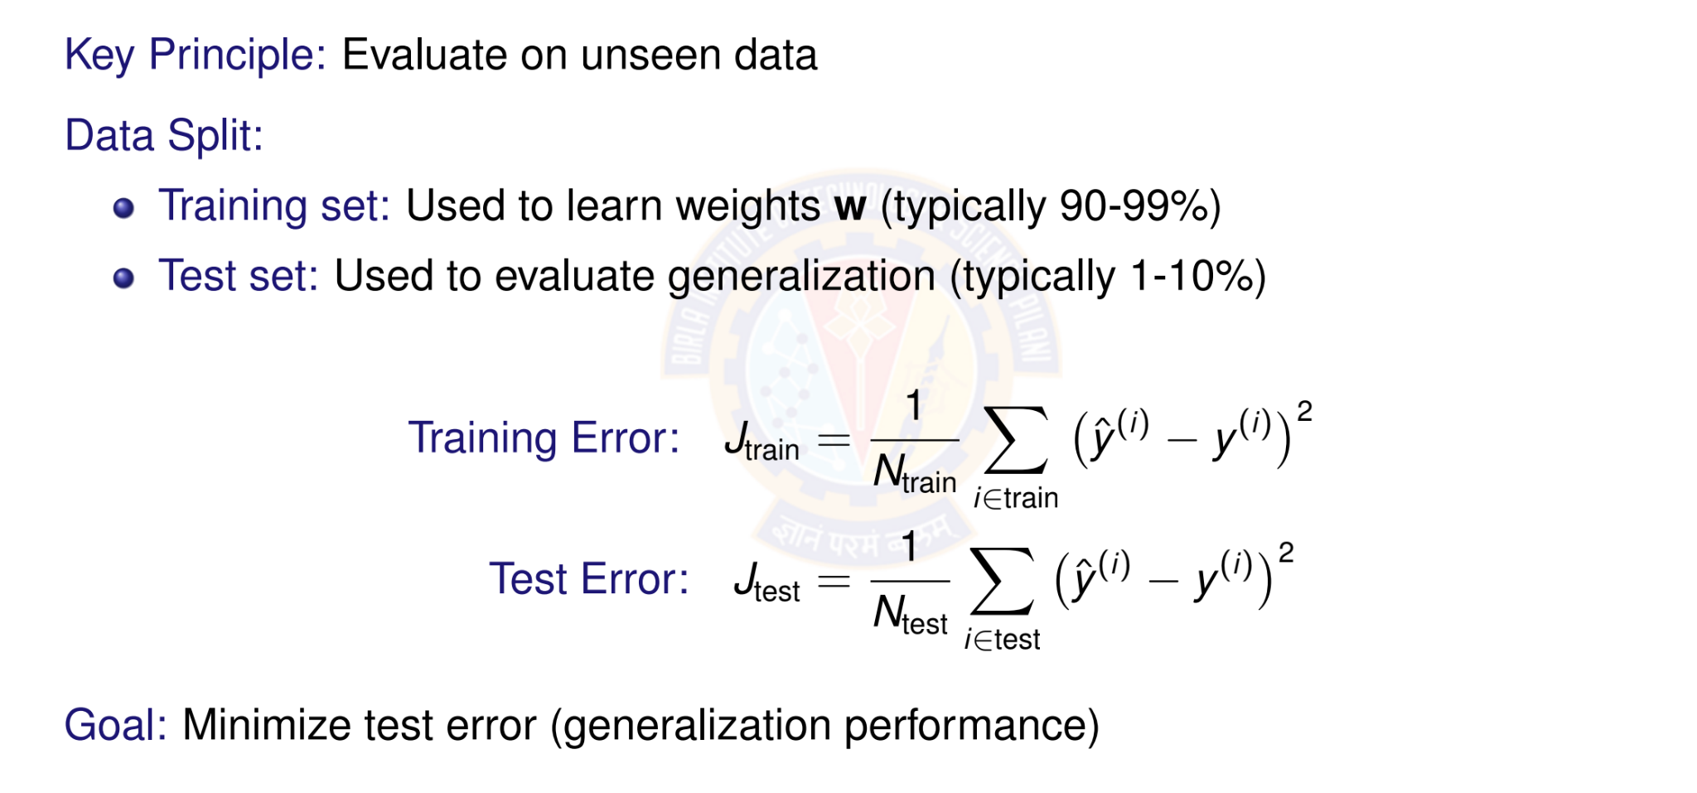
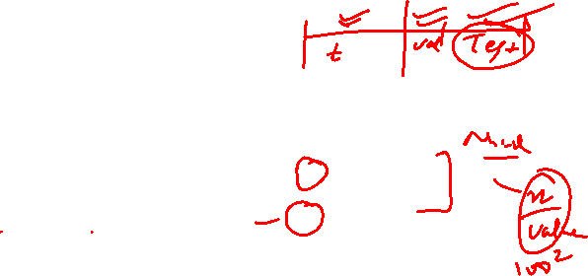
Model Evaluation: Training vs Test Error
Deep Learning
Notes:
“After training, we must ask: Will this model work on new data it has never seen? That’s called generalization. So the key principle is: evaluate on unseen data.”
“We split the dataset into two parts:
Training set: used to learn the weights $w$. Usually most of the data (like 90–99%).
Test set: kept aside and used only to check how well the model generalizes (often 1–10%).”
“Training is like practicing questions; test is the final exam with new questions.”
“This is the average squared prediction error on training data. We square the errors so negative/positive don’t cancel, and big mistakes are penalized more.”
“This is the same thing, but on test data that the model did not see during training.”
“Our true goal is: minimize test error, because that measures real-world performance.”
“Why not just minimize training error?” Because a model can memorize training data and still fail on new data — that’s overfitting

Slide 13
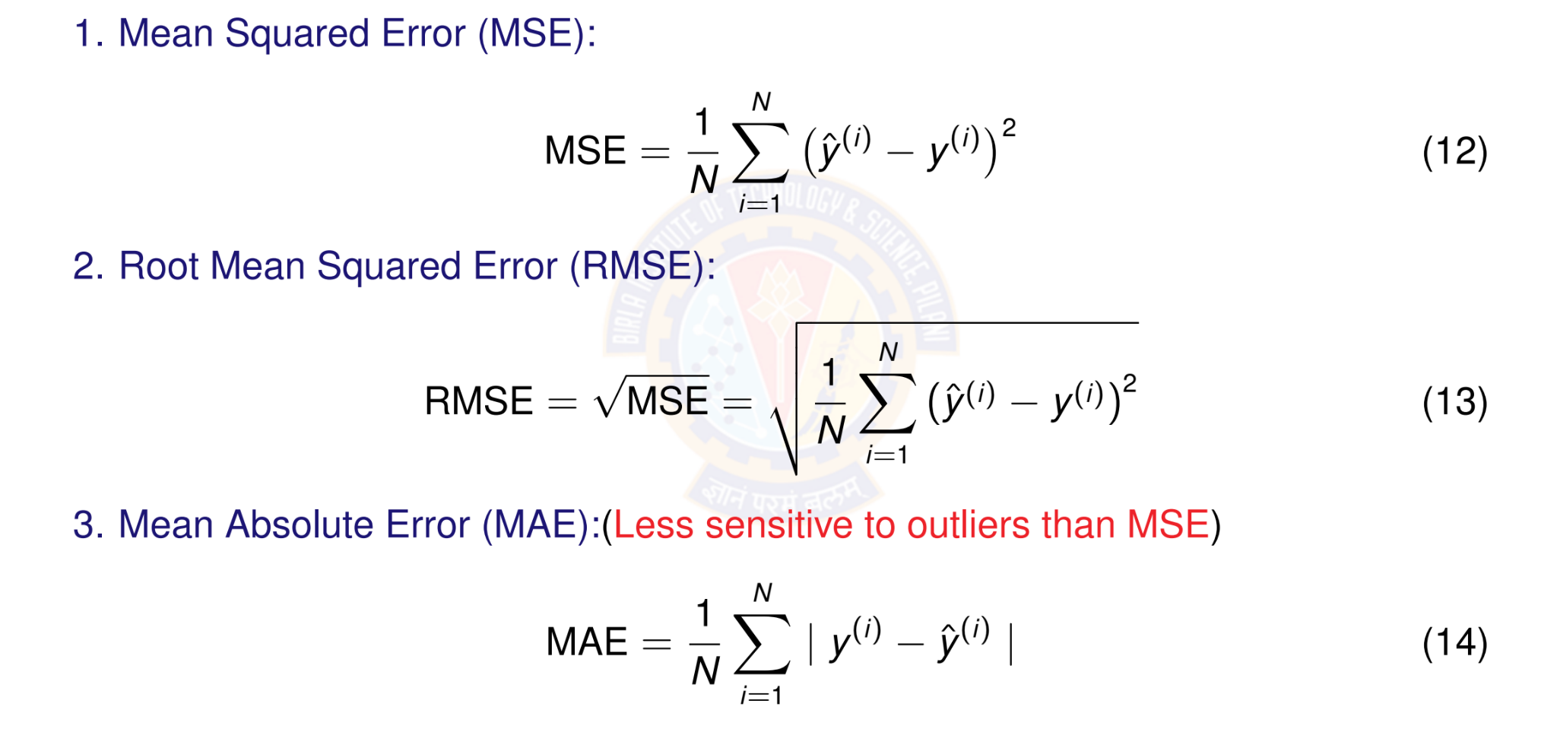
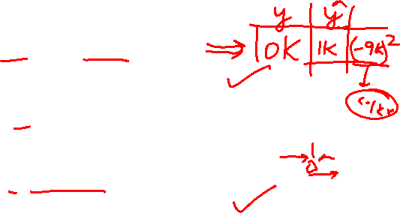
Evaluation Metrics
Deep Learning
Notes:
“Now we’ll talk about how we measure error. Different metrics tell different stories.”
MSE is the average squared error.
Squaring makes all errors positive
And it penalizes big errors a lot (because big errors squared become huge)
“Good when big mistakes are especially costly.”
“RMSE is just the square root of MSE. Why do we do that? Because it brings the metric back to the same units as the target. If $y$is in dollars, RMSE is also in dollars.”
“MAE is the average absolute error. It’s simpler: we take absolute value instead of squaring. Important: MAE is less sensitive to outliers than MSE — meaning a few extreme points won’t dominate the score as much.”
Root Mean Absolute Error (RMSE) is a metric used to measure the difference between predicted and actual values in a dataset, calculated by taking the square root of the average of the squared differences between the predicted and actual values.
Mean Absolute Error (MAE) is a metric that measures the average magnitude of the errors between paired observations, such as predicted versus actual values. It is calculated by taking the average of the absolute differences between the predicted and actual values, making it robust to outliers.

Slide 14
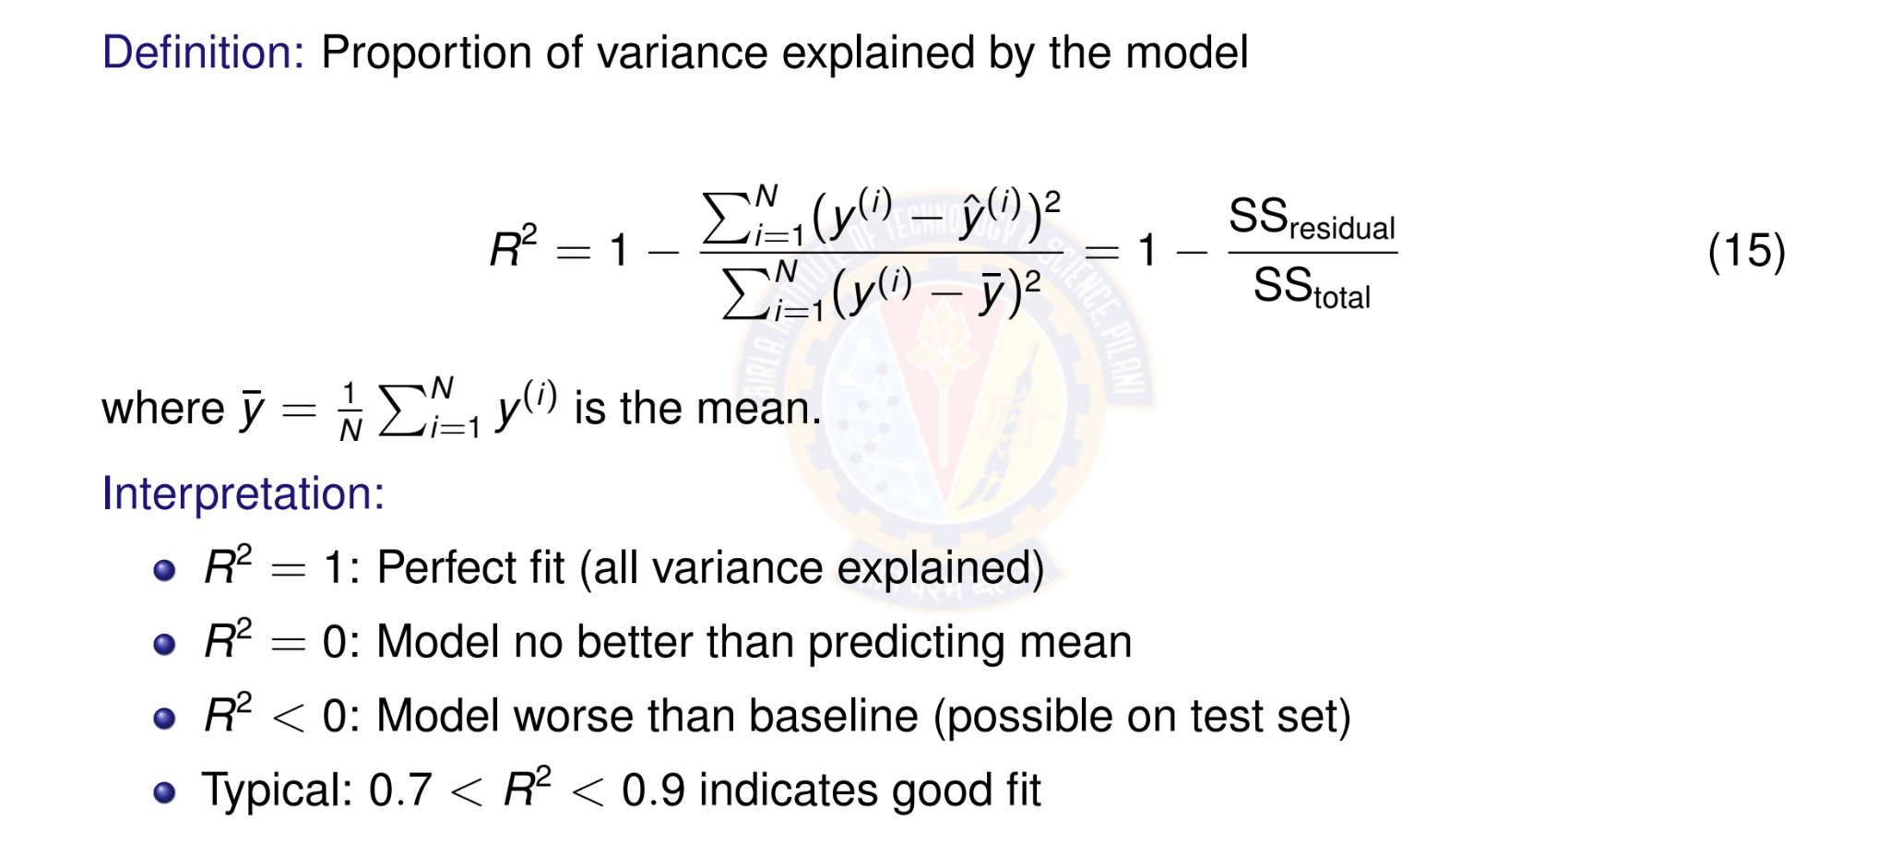
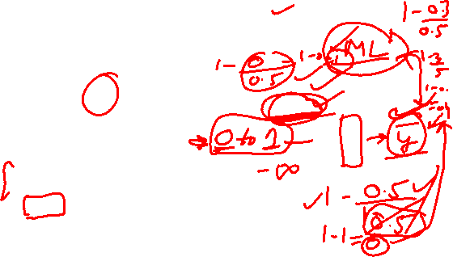
R² Score (Coefficient of Determination)
Deep Learning
Notes:
The R² (R-squared) score in linear regression is a statistical measure that represents the proportion of the variance in the dependent variable that is predictable from the independent variable(s). It's often called the coefficient of determination and indicates how well the regression model's predictions fit the actual data. A score of 1 (or 100%) means the model perfectly predicts the data, while a score of 0 means the model is no better than simply predicting the average value.
$SS_{res}$ is the "residual sum of squares," which measures the variance around the regression line (the sum of the squared differences between the actual and predicted values).
$SS_{tot}$is the "total sum of squares," which measures the total variance in the data (the sum of the squared differences between the actual values and the mean of the dependent variable).
High R²: A high R² value, closer to 1, indicates that a large portion of the variance in the dependent variable can be explained by the independent variables in the model.
Low R²: A low R² value, closer to 0, suggests that the model's predictions don't fit the data well and much of the variance is due to other factors not included in the model.
Context is key: While a higher R² is often better, the interpretation of a "good" score depends on the field of study. For example, a high R² in physics might be 0.99, but in social sciences, an R² of 0.5 might be considered strong
“R² tells us: how much of the variance in $y$is explained by the model.”
“Think of this as a comparison:
Top: the model’s total squared error (residual sum of squares)
Bottom: the error if we used the simplest baseline: always predict the mean $\overset{ˉ}{y}$(total sum of squares) So R² measures: How much better are we than just predicting the mean?”
“So:
1 means we explained everything
0 means we’re no better than a naive baseline
negative means the model is actually harmful compared to predicting the mean.”

Slide 15

Table of Contents
Regression
Linear Regression
The Linear Model: Single Neuron
Worked Example
Evaluation
Python Implementation Implementation Tips
Summary
1
2
3
4
5
6
7
8
Deep Learning

Slide 16
Perceptron Demo Python Code
https://drive.google.com/file/d/1Qs9sAvBcfyr_bCpAKam9hRDXEw-K-ONF/view?usp=sharing
Already shown in webinar.
Student pl note:
The Python notebook is shared for anyone who has access to the link and the access is restricted to use BITS email id. So please do not access from non-BITS email id and send requests for access. Access for non-BITS email id will NOT be granted.
Deep Learning

Slide 17

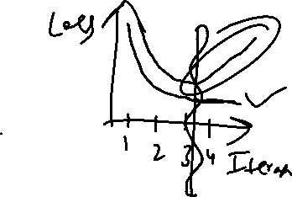
Table of Contents
Regression
Linear Regression
The Linear Model: Single Neuron
Worked Example
Evaluation
Python Implementation Implementation Tips
Summary
1
2
3
4
5
6
7
8
Deep Learning

Slide 18
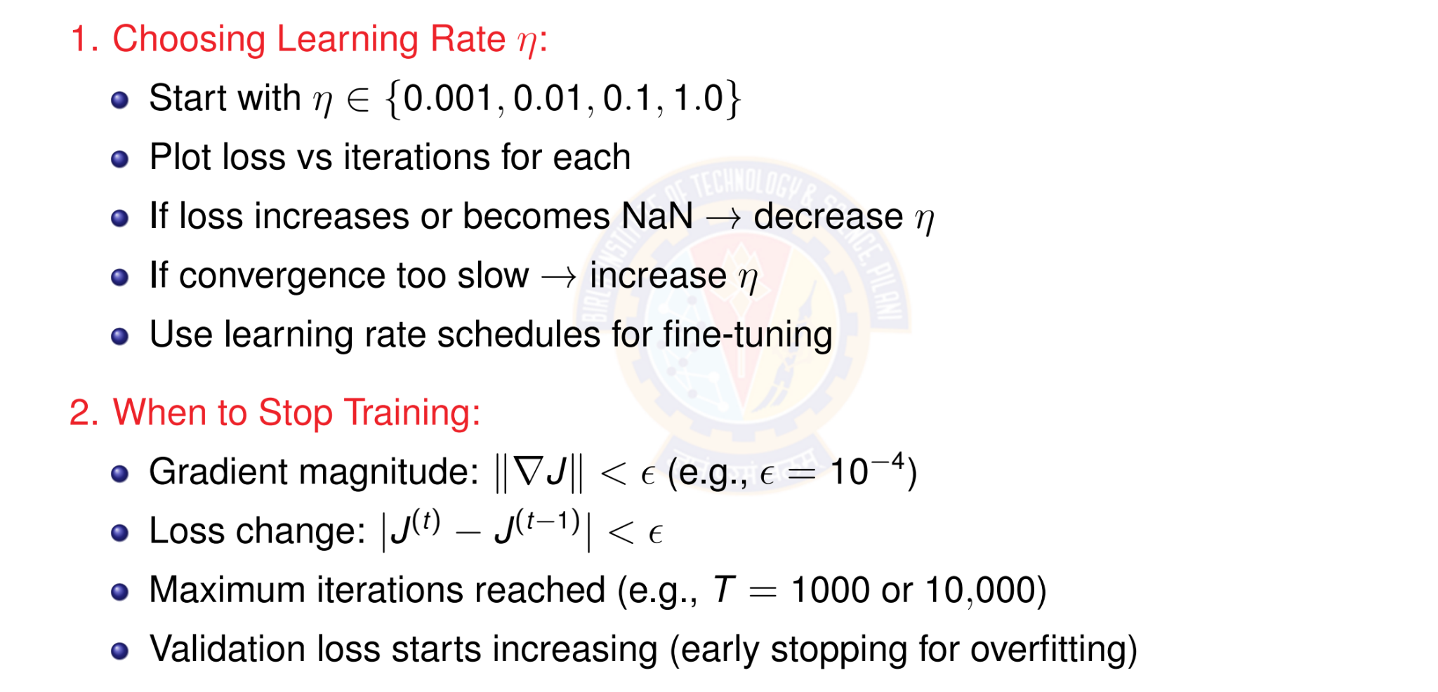
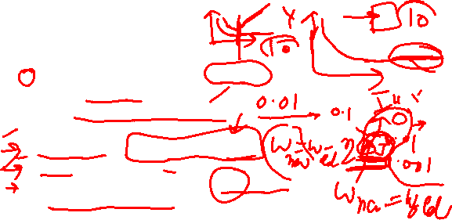
Tips for Implementation
Deep Learning
Notes:
η is the step size in gradient descent: how big a jump we take each update.
If your steps are too big, you overshoot and bounce around (or blow up).
If your steps are too small, you take forever.”
Plot loss vs iterations for each learning rate and compare.
If loss increases or becomes NaN, it usually means steps are too big → decrease $η$.
If convergence is too slow, increase $η$.
Use learning rate schedules for fine-tuning (reduce $η$later).
“Learning rate is the #1 knob: too high = unstable, too low = slow.”
We need a stopping rule so training doesn’t run forever or overfit.
Gradient magnitude small: $∥∇J∥<ε$(example $ε={10}^{−4}$). Simple meaning: “The slope is almost flat now — we’re near the bottom.”
Loss change small: $∣J^{\left(t\right)}−J^{\left(t−1\right)}∣<ε$. Simple meaning: “Loss is not improving anymore.”
Max iterations reached: e.g., $T=1000$or $10,000$. Simple meaning: “We cap compute time.”
Validation loss starts increasing → early stopping (overfitting warning). Simple meaning: “Model is starting to memorize training; stop before it gets worse on unseen data.”
“We stop when improvement becomes tiny, or when validation starts getting worse.”

Slide 19
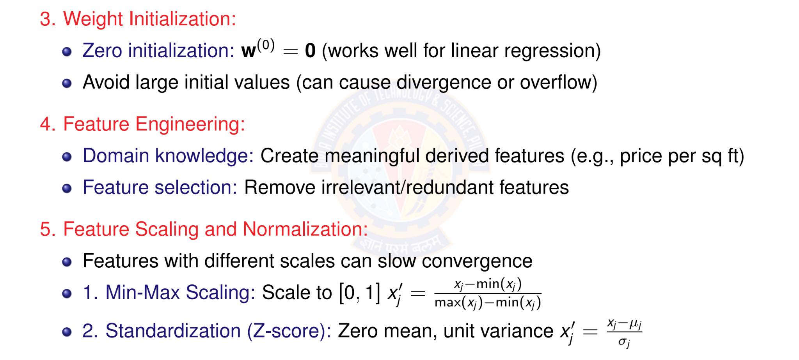
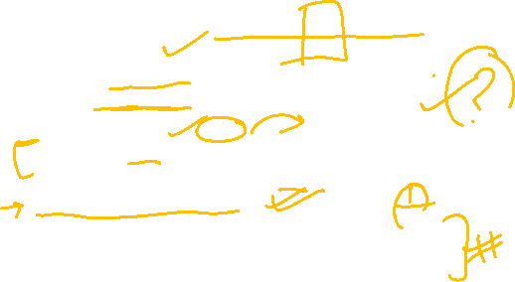
More Practical Tips
Min Max - Sensitive to outliers: if one extreme max exists, everything else squashes near 0.
Deep Learning
40 / 46
Notes:
“Big starting weights can make predictions huge, which makes errors huge, which makes updates explode.”
“A model can only learn patterns that exist in the input features. Better features → easier learning.”
“Features are the ‘questions’ we allow the model to look at. If we ask better questions, we get better answers.”
if features have different scales, training becomes slow or unstable.
Because gradient descent updates are influenced by feature magnitudes. If one feature is 0–1 and another is 0–1,000,000, the big one dominates updates.
“Scaling makes all features ‘speak the same volume’, so gradient descent can move smoothly.”

Slide 20
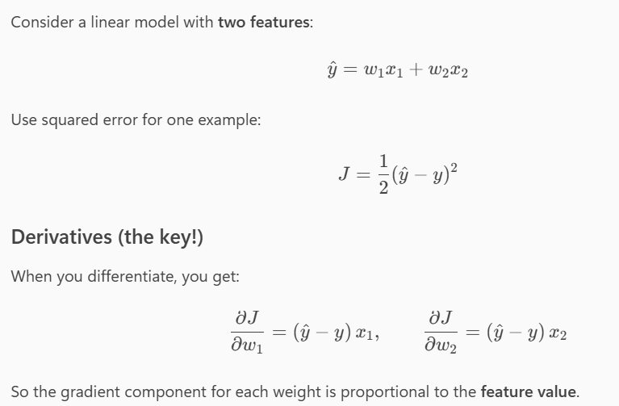
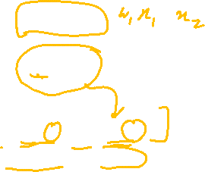

Slide 21
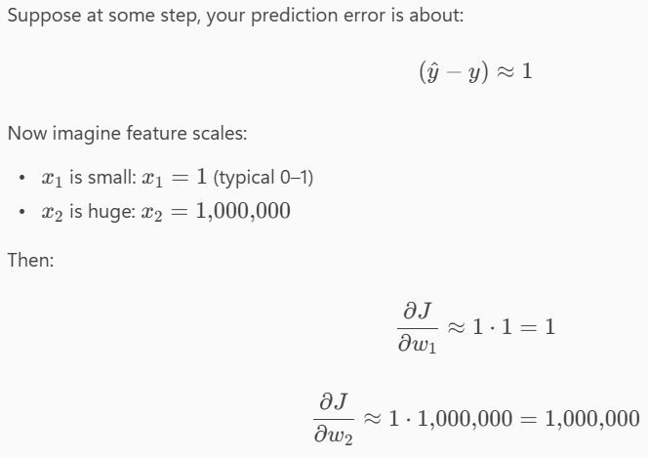
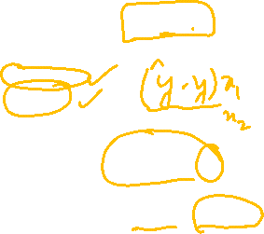

Slide 22
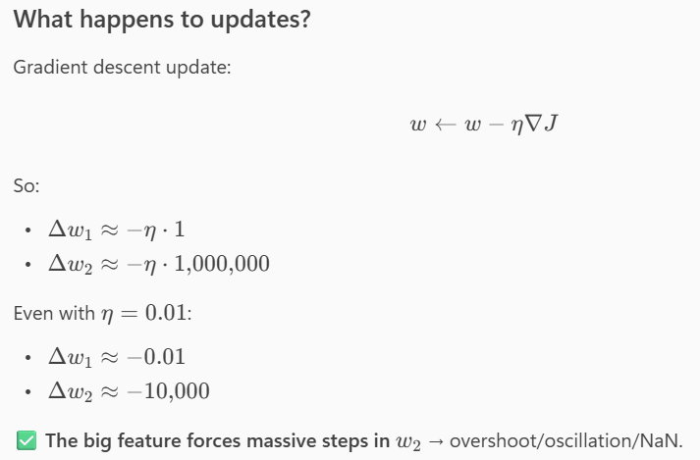
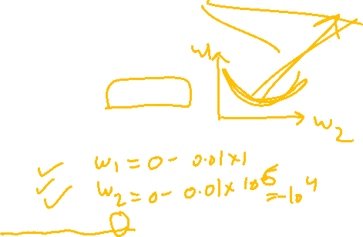

Slide 23
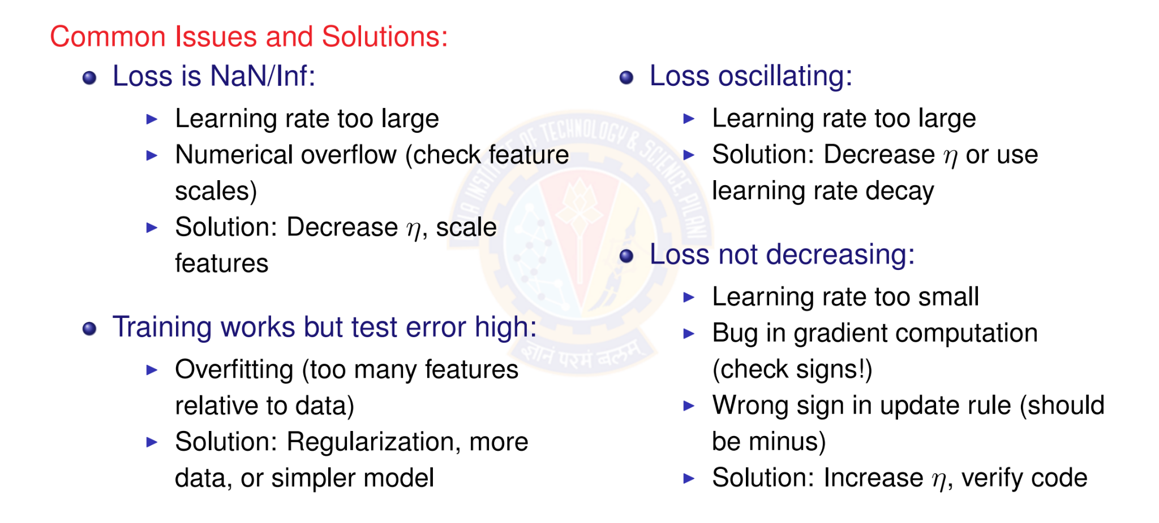
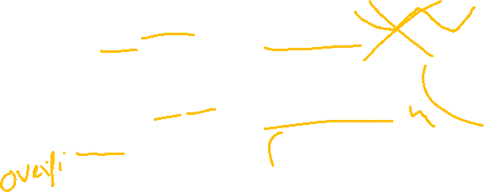
Debugging Checklist
Deep Learning
Notes:
Likely causes:
Learning rate too large
Numerical overflow (feature scales too large)
Fix:
Decrease $η$
Scale features
“NaN usually means the math blew up — most often because steps were too big or numbers were too large.”
Symptom B: Training works but test error high
Cause:
Overfitting (too many features relative to data)
Fix:
Regularization, more data, or simpler model
“Low training error + high test error = memorization, not learning.”
Symptom C: Loss oscillating
Cause:
Learning rate too large
Fix:
Decrease $η$or use learning rate decay
“Oscillation means we keep jumping across the minimum.”
Symptom D: Loss not decreasing
Causes:
Learning rate too small
Bug in gradient computation (check signs!)
Wrong sign in update rule (should be minus)
Fix:
Increase $η$, verify code
“If loss doesn’t go down at all, either we’re moving too slowly… or we’re moving in the wrong direction.”

Slide 24

Table of Contents
Regression
Linear Regression
The Linear Model: Single Neuron
Worked Example
Evaluation
Python Implementation Implementation Tips
Summary
1
2
3
4
5
6
7
8
Deep Learning

Slide 25


Summary: Putting It All Together
1. Data & Initialization
D = {(x^{(i)}, y ^{(i)})}
_{w}(0) ₌ ₀
2. Model
x₁
^{x2} Σ y^{ˆ}
x_{d}
Linear Activation Function
forward
iterate
Linear Regression Model
compute
4. Learning
—η∇J
_{w}(t ) _{w}(t +1)
3. Objective
minimum
J(w)
MSE Loss Function
gradient
This framework extends to more complex models: neural networks, deep learning!
Deep Learning
Notes:
1. Data & Initialization: The process begins with a dataset $D=\left\{\left(x^{\left(i\right)} , y^{\left(i\right)}\right)\right\}$ consisting of input-output pairs. The model's weight vector $w$ is initialized, often to zero ($w^{\left(0\right)}=0$
2. Model: The initialized weights are used in a linear activation function to make a prediction $y$ based on the input features $x_{1},x_{2},…,x_{d}$.This is the "forward" pass.
3. Objective: The predicted output from the model is compared to the actual data using an objective function, specifically the Mean Squared Error (MSE) Loss Function $J\left(w\right)$.
The goal is to find the minimum point of this function, which corresponds to the best-fitting model weights.
4. Learning: The model iteratively updates the weights using a gradient-based optimization method. The negative gradient ( $−η∇J$) which indicates the direction of the steepest descent towards the minimum loss, is used to update the current weights $w^{\left(t\right)}$ to new weights $w^{\left(t+1\right)}$. This "iterate" step repeats until the model converges to a minimum loss.

Slide 26
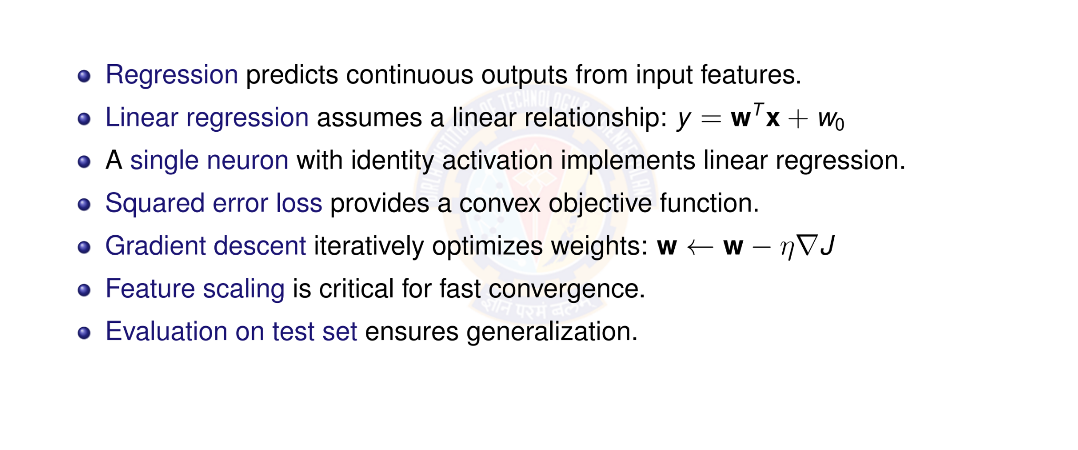
Key Takeaways
Deep Learning

Slide 27

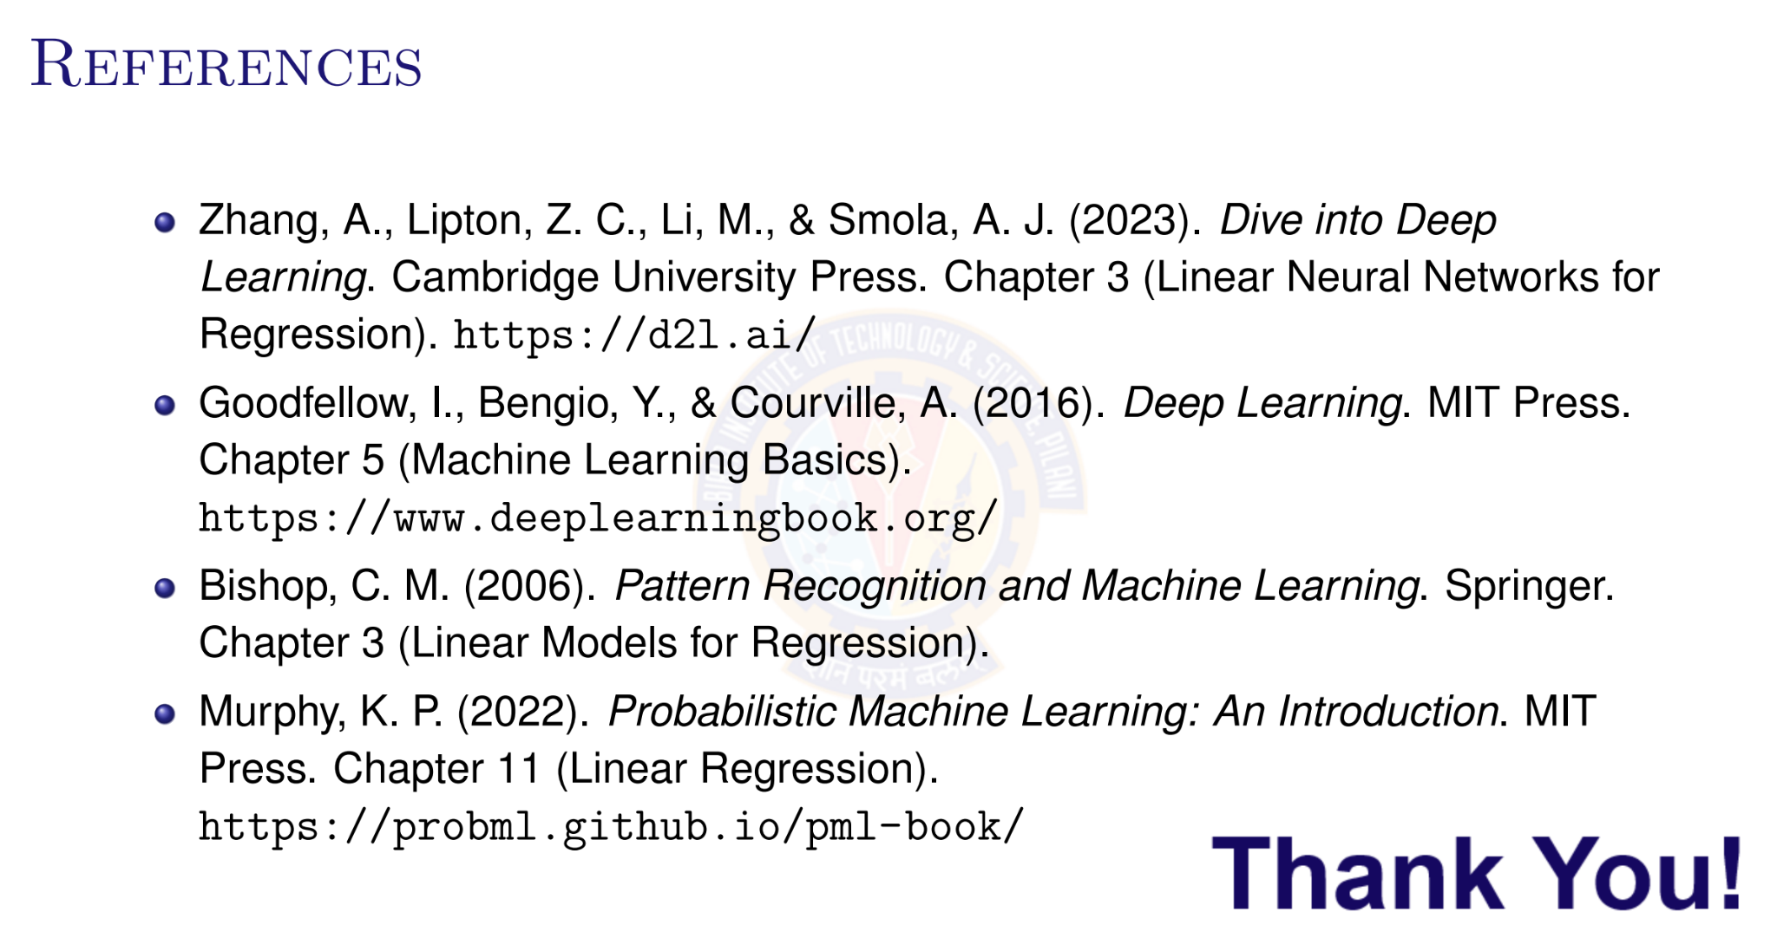
Deep Learning

